Slide 2
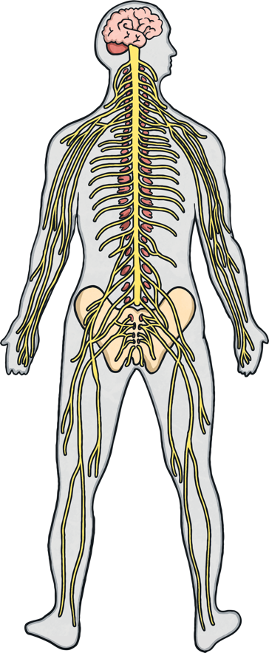
Purpose of the Nervous System
The nervous system is a complex network of cells that transmit impulses (also called ‘messages’) to and from the brain and spinal cord to different parts of the body.
This network governs how our bodies respond to different situations and sensations.

Slide 3
Components of the Nervous System
brain
spinal chord
nerves

Slide 4
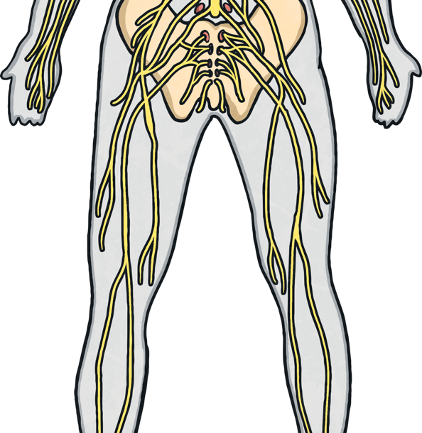
1. Nerves
Nerves are the long fibres that transmit messages from the brain and spinal cord (the central nervous system) to the rest of the body (the peripheral nervous system) and back again.
Your brain contains billions of nerve cells called neurons that act as the ‘messengers’ between your brain and spinal cord and the rest of the body.
The ‘messages’ carried back and forth dictate how we move, think, learn and behave.
There are two ways that the nervous system receives stimuli:
Sensory neurons are activated through touch, sight, smell, sound and taste.
Motor neurons carry the messages away from the brain and spinal cord to the rest of the body.

Slide 5
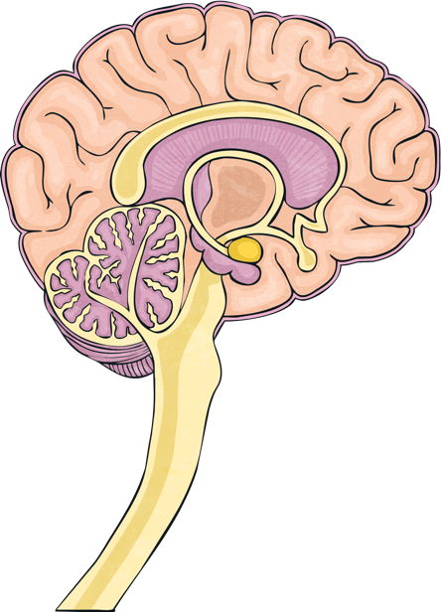
2. Brain
The brain forms part of the central nervous system and consists of many folds and grooves; it is protected by the bones in your skull.
Despite its importance, the brain only weighs around 1,4kg!
When the brain receives a message from anywhere in the body, it tells the body how to react.
The brain is divided into three areas:
The forebrain
The midbrain
The hindbrain
Each of these areas has different functions and they all communicate with each other.
The brain is attached to the spinal cord through the brain stem.

Slide 6
3. Spinal Cord
The spinal cord is a long (45,7cm) bundle of nerves that forms part of the central nervous system.
It runs from the brain stem down your spine and extends to the other parts of your body
The spinal cord is also protected: ring-shaped bones called vertebrae and a special fluid called cerebrospinal fluid cushion the nerves.
Peripheral nerves stem from the spinal cord to the rest of the body like threads.

Slide 7
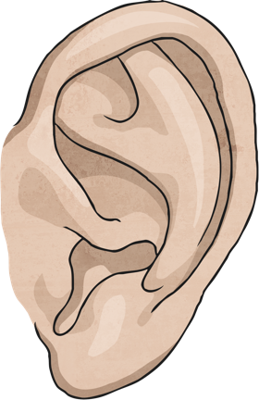
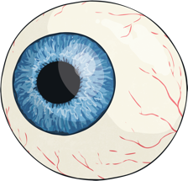
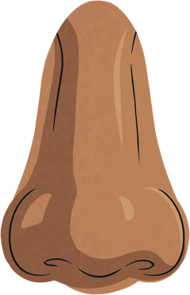
4. Sensory Organs
The peripheral nervous system is the second part of the nervous system within our bodies and stems from the central nervous system through the spinal cord.
The peripheral nervous system carries neurons to various muscles and organs in the body.
Sensory organs are muscles and organs based on the five senses:
ears (hearing)
nose (smelling)
eyes (seeing)
skin (feeling)
tongue (tasting)
These organs are responsible for gathering information all throughout the body and sending it via sensory nerves to the central nervous system.

Slide 8
Main Processes in the Nervous System
The nervous system is responsible for key processes in the body and the body cannot optimally function if parts of it are damaged.
The nervous system sends and receives electrical impulses from multiple sources at any given moment and determines how we sense the world around us.

Slide 9
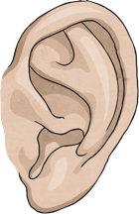
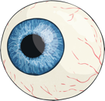

Main Processes in the Nervous System
These processes are:
Hearing
Sound waves are transformed into electrical signals that travel along the auditory nerve to the brain. This makes us understand what we are hearing.
Seeing
Seeing and understanding what you are seeing are complex processes. Light enters your eye upside-down and stimulates specialised cells in your eye. These cells broadcast signals to the brain along the optic nerve, where they are turned around and interpreted as sight.
Feeling
The skin allows us to feel and experience everything around us through touch. There are millions of nerve endings called receptors in the skin, muscles, bones and joints, internal organs and the circulatory system. These receptors respond to pressure, pain, movement and temperature.

Slide 10
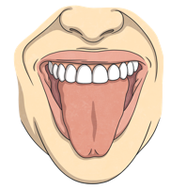

Main Processes in the Nervous System
Tasting
Taste buds on your tongue and parts of your mouth can distinguish between different flavours: sweet, sour, bitter and salty. These receptors and the receptors in the nose work very closely together. The taste and scent of food are sent to the brain where it is processed and interpreted.
Smelling
Nerve cells in the lining of your nose react to molecules in the air. They send messages to the brain which interprets the smell accordingly and recognises any of +- 10 000 different smells!

Slide 11
Main Processes in the Nervous System
Regulating
It is important to maintain a balance within the human body. It includes regulating our body temperature. Our bodies need to be kept at about 37ᵒC to work best. If the body is too hot, the brain might try and cool the body down through increased sweating. When you are very cold, your body will shiver to generate heat energy. Your nervous system controls these responses to changes in body temperature.

Slide 12
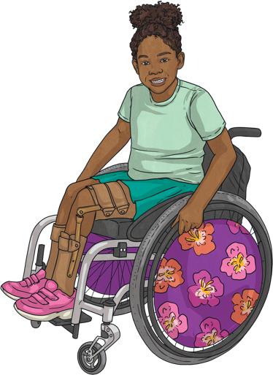
Health Issues Involving the Nervous System
The loss of nervous function, where nerves ‘die’ and cease to function as they should, is also known as neuropathy.
Neuropathy can be caused by the following factors:
Traumatic brain and spinal cord injuries
Any damage to the brain or spinal cord can have harmful effects on the human body. For example, people who break their necks in an accident frequently damage their spinal cord. This prevents the brain from sending and receiving messages to the body and the person can become either partly or fully paralysed.
Strokes
Brain cells begin to die when blood flow to the brain is cut off, even after just a few minutes without blood or oxygen. This can cause a stroke where a part of the brain function is lost.

Slide 13
Health Issues Involving the Nervous System
Degenerative disorders
There are several problems related to the nervous system that causes a gradual loss of function over time. This includes Alzheimer's Disease, Parkinson's Disease and Multiple Sclerosis.
Diabetic complications
Uncontrolled diabetes can lead to a lack of proper functioning of the nerves, making patients lose sensation in their extremities (hands and feet) first but eventually affecting more organs and senses.
Mental health problems
Examples are depression, anxiety disorder and personality disorders.

Slide 14


Health Issues Involving the Nervous System
Other sensory organ problems
These include deafness, blindness and short-sightedness
Substance abuse
Different types of drugs target different areas in the brain and abuse leads to the disruption of normal brain function as it interferes with the messages carried back and forth between neurons.

